Slide 1




Dual Stack Virtualization: Consolidating HPC and commodity workloads in the cloud
Brian Kocoloski, Jiannan Ouyang,
Jack Lange
University of Pittsburgh

Slide 2
Summary
Cloud computing holds great promise for HPC
  Significant interest in scientific computing community
Problem: HPC applications need HPC environments
  Tightly coupled, massively parallel, and synchronized
  Current services must provide dedicated HPC clouds
Can we host HPC applications in a commodity cloud?
Dual Stack Approach
  Provision the underlying software stack along with HPC job
  Commodity VMM should handle commodity applications
  HPC VMM (Palacios) can provide HPC environment

Slide 3
HPC in the cloud
Clouds are starting to look like supercomputers…
  Are we seeing a convergence?
Not yet
  Noise issues
  Poor isolation
  Resource contention
  Lack of control over topology
Very bad for tightly coupled parallel apps
  Require specialized environments that solve these problems
Approaching convergence
  Vision: Dynamically partition cloud resources into HPC and commodity zones
  This talk: partitioning compute nodes with performance isolation

Slide 4
User Space Partitioning
Current cloud systems do support this, but…
Interference still exists inside the OS
  Inherent feature of commodity systems
Socket 1
Socket 2
Memory
Cores
Cores
Memory
1
2
5
6
3
4
7
8
Commodity Partition
HPC Partition

Slide 5
HPC vs. Commodity Systems
Commodity systems have fundamentally different focus than HPC systems
  Amdahl’s vs. Gustafson’s laws
  Commodity: Optimized for common case
HPC: Common case is not good enough
  At large (tightly coupled) scales, percentiles lose meaning
  Collective operations must wait for slowest node
  1% of nodes can make 99% suffer
  HPC systems must optimize outliers (worst case)

Slide 6
Commodity VMMs
Virtualization is considered an “enterprise” technology
  Designed for commodity environments
  Fundamentally different, but not wrong!
Example: KVM architecture issues
  Userspace handlers
  Fairly complex memory management
  Locking and periodic optimizations
  Presence of system noise

Slide 7
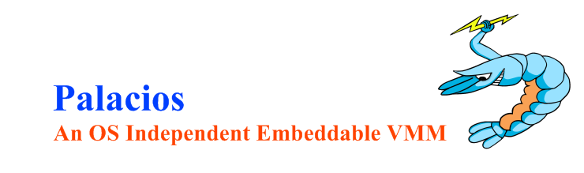
Palacios VMM
OS-independent embeddable virtual machine monitor
  Established compatibility with Linux, Kitten, and Minix
Specifically targets HPC applications and environments
  Consistent performance with very low variance
Deployable on supercomputers, clusters (Infiniband/Ethernet), and servers
  0-3% overhead at large scales (thousands of nodes)
    VEE 2011, IPDPS 2010, ROSS 2011
Open source and freely available
  http://www.v3vee.org/palacios

Slide 8
Palacios/Linux
Palacios/Linux provides lightweight and high performance virtualized environments
  Internally manages dedicated resources
    Memory and CPU scheduling
  Does not bother with “enterprise features”
    Page sharing/merging, swapping, overcommitting resources
Palacios enables scalable HPC performance on commodity platforms

Slide 9
VMM Comparison
Primary difference: Consistency
  Requirement for tightly coupled performance at large scale
Example: KVM nested paging architecture
  Maintains free page caches to optimize performance
    Requires cache management
  Shares page tables to optimize memory usage
    Requires synchronization
VMM | % of exits | Mean | Std Dev | # NPFS
KVM | 52% | 8804 | 5232 | 3,265,156
Palacios | 50% | 10876 | 2685 | 1,872,017

Slide 10
Dual Stack Architecture
Partitioning at the OS level
Commodity Application(s)
HPC Application
Commodity OS
HPC OS
KVM
Palacios VMM
Linux Kernel
Linux Module Interface
Palacios Resource
Managers
Hardware
Enable cloud to host both commodity and HPC apps
  Each zone optimized for the target applications

Slide 11
Evaluation
Goal: Measure VM isolation properties
Partitioned a single node into HPC and commodity zones
  Commodity Zone: Parallel Kernel compilation
  HPC Zone: Set of standard HPC benchmarks
  System:
    Dual 6-core AMD Opteron with NUMA topology
    Linux guest environments (HPC and commodity)
Important: Local node only
  Does not promise good performance at scale
  But, poor performance will magnify at large scales

Slide 12
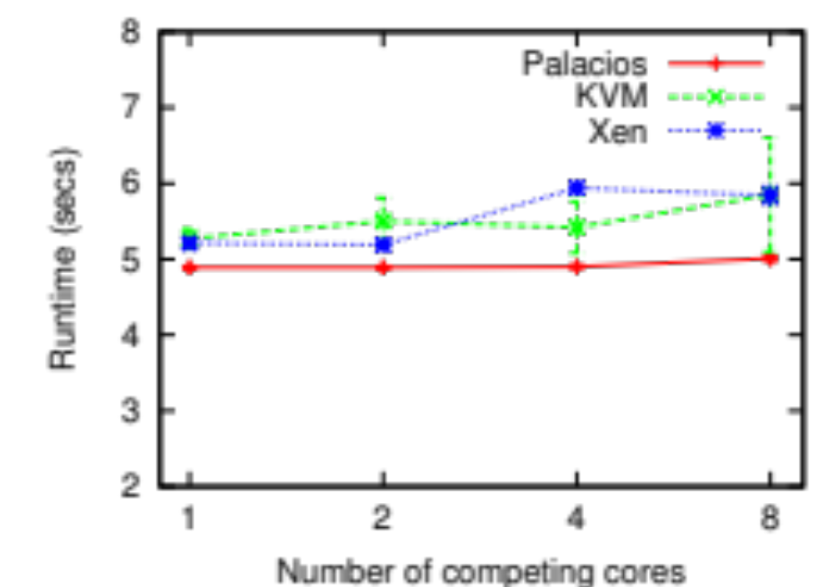
Results
Commodity VMMs degrade with contention
Palacios delivers
consistent performance
MiniFE: Unstructured implicit finite element solver
Mantevo Project -- https://software.sandia.gov/mantevo/index.html

Slide 13
Discussion
A dual stack approach can provide HPC environments in commodity systems
  HPC and commodity workloads can dynamically share resources
  HPC requirements can be met without fully dedicated resources
Networking is still an open issue
  Need mechanisms for isolation and partitioning
  Need high performance networking architectures
    1Gbit is not good enough
    10Gbit is good, Infiniband is better
  Need control over placement and topologies

Slide 14
Conclusion
The cloud model is transformative for HPC workloads
  But only if it can meet the demands of HPC users
Cloud services need to explicitly support HPC workloads
  Different requirements and behaviors than commodity applications
A partitioned dual stack approach can get us there
  Dynamically configured cloud infrastructures for multiple application classes

Slide 15
Thank you
Jack Lange
  jacklange@cs.pitt.edu
  http://www.cs.pitt.edu/~jacklange
Palacios
  http://www.v3vee.org/palacios

