Slide 1








Minimal-overhead Virtualization of a Large Scale Supercomputer
John R. Lange and Kevin Pedretti,
Peter Dinda, Chang Bae,
Patrick Bridges, Philip Soltero,
Alexander Merritt
University of Pittsburgh
Northwestern University
Sandia National Labs
University of New Mexico

Slide 2
Summary
Palacios
  First VMM for scalable HPC
  Open Source and available
Kitten
  First open source Lightweight Kernel for High Performance Computing (HPC)
  Open Source and available
Palacios: A New Open Source Virtual Machine Monitor for Scalable High Performance Computing, Lange, et al (IPDPS 2010)
HPC virtualization at scale
  Performance within 3% of native
  Large scale study of virtualization (4096 nodes)

Slide 3
Outline
Palacios and Kitten
  VMM/OS for HPC virtualization
Large scale test
  Parallel apps running on supercomputer
Minimal overhead techniques
  Passthrough I/O
  Virtual Paging
  Controlled Preemption

Slide 4
Virtualization in HPC
Virtualization benefits applied to HPC
  Fault tolerance
  Broader usage for legacy applications
  Testbeds for future exascale systems
DOE X-Stack project to deploy virtualization on future exascale systems
  UNM, NWU, Pitt, SNL, ORNL
Only if it doesn’t degrade performance…
  Tightly coupled parallel applications
  petascale and soon exascale
Notes:
Same advantages as enterprise environments, two differences: tightly coupled applications + scale, need to deal with faults, broader usage is nice

Slide 5

Palacios VMM
OS-independent embeddable virtual machine monitor
Open source and freely available
Virtualization layer for Kitten
  Lightweight supercomputing OS from Sandia National Labs
Successfully used on supercomputers, clusters (Infiniband and Ethernet), and servers
  http://www.v3vee.org/palacios

Slide 6
Kitten: An Open Source LWK
Better match for user expectations
  Provides mostly Linux-compatible user environment
    Including threading
  Supports unmodified compiler toolchains and ELF executables
Better match vendor expectations
  Modern code-base with familiar Linux-like organization
    Drop-in compatible with Linux
  Infiniband support
http://code.google.com/p/kitten/
Notes:
Part of DOE Xstack program to develop future systems software for future exascale systems

Slide 7
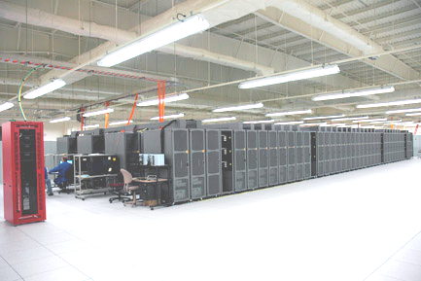
HPC Performance Evaluation
Virtualization is useful for HPC, but…
  Only if it doesn’t hurt performance
Virtualized RedStorm with Palacios
  Evaluated with Sandia’s system evaluation benchmarks
Cray XT3
38208 cores
~3500 sq ft
2.5 MegaWatts
$90 million

Slide 8
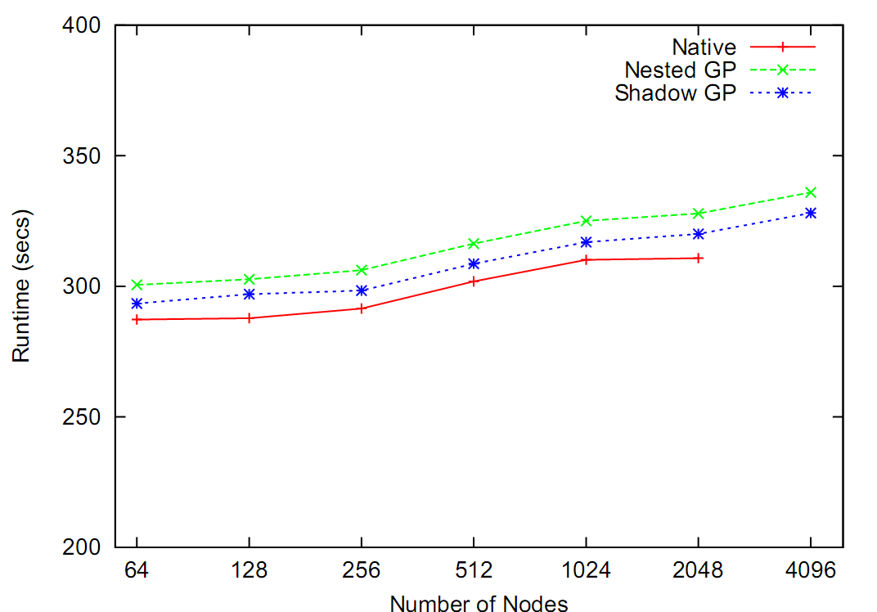
Scalability at Large Scale (Weak Scaling)
Catamount Guest OS
Within 3%
Scalable
CTH: multi-material, large deformation, strong shockwave simulation

Slide 9
Minimal Overhead Virtualization
Passthrough I/O
  Direct I/O access with no virtualization overheads
Optimized virtual paging
  Nested and shadow paging optimizations
Controlled Preemption
  Host OS noise minimization
  Characterizing application sensitivity to OS interference using kernel-level noise injection, Ferreira, et al (Supercomputing 2008)
Notes:
Rework For Problems->Solutions

Slide 10
Passthrough I/O
I/O virtualization significantly degrades performance
Mitigated by hardware support
  SRIOV/IOMMUs
In HPC we can do better
  Passthrough I/O without any translation overhead

Slide 11
Passthrough I/O architecture
Guest Offset
Guest Memory
PCI
DEV
Host Memory
DMA_Address = Guest_DMA_Address + Guest_Offset
if (DMA_Address > (guest_memory_size + Guest_Offset)) {
//error
}

Slide 12
Trust
HPC environments run trusted software stacks
  Can rely on guest/VMM cooperation
Guest directly controls DMA operations
  But sets DMA addresses cooperatively with VMM
  The VMM trusts the guest to do DMA correctly
DMA address calculations are centralized in guest OS
  Linux DMA modifications: 20 lines of code

Slide 13
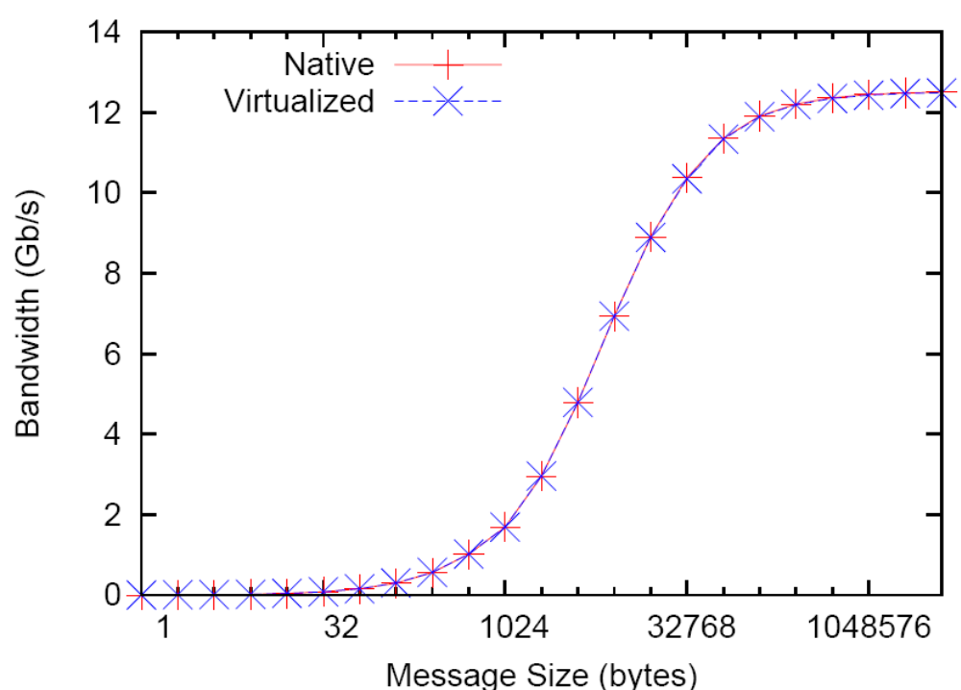
Infiniband on Commodity Linux
(Linux guest on IB cluster)
2 node Infiniband Ping Pong bandwidth measurement

Slide 14
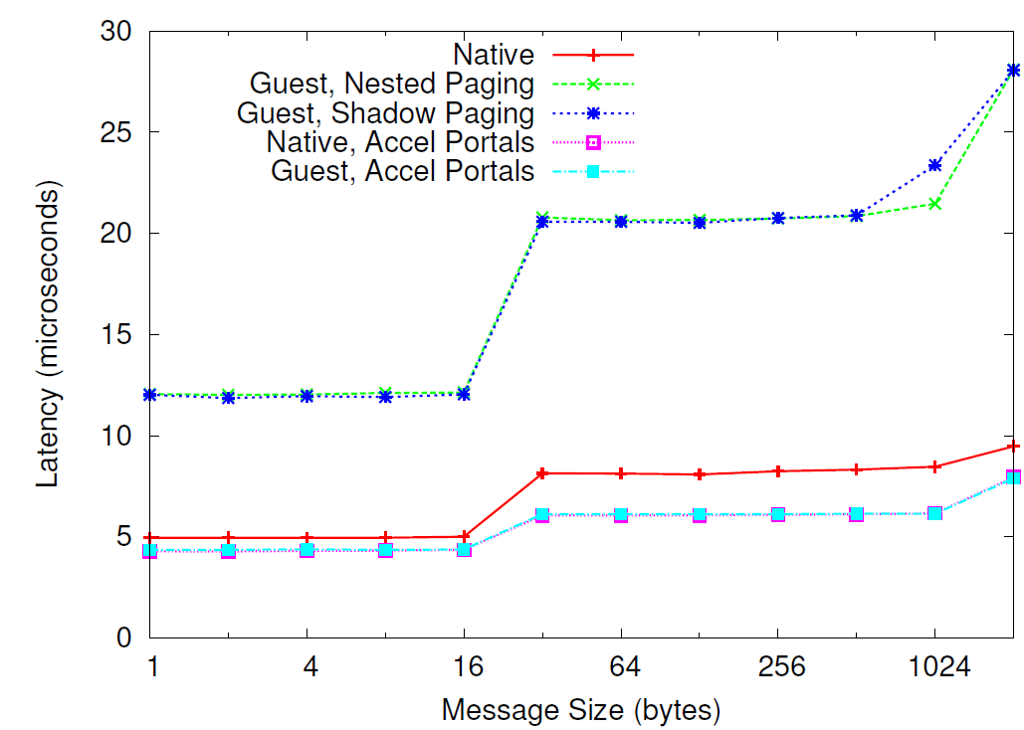
Interrupt Overheads
Interrupt Driven
Polling
MPI Ping-Pong Latency

Slide 15
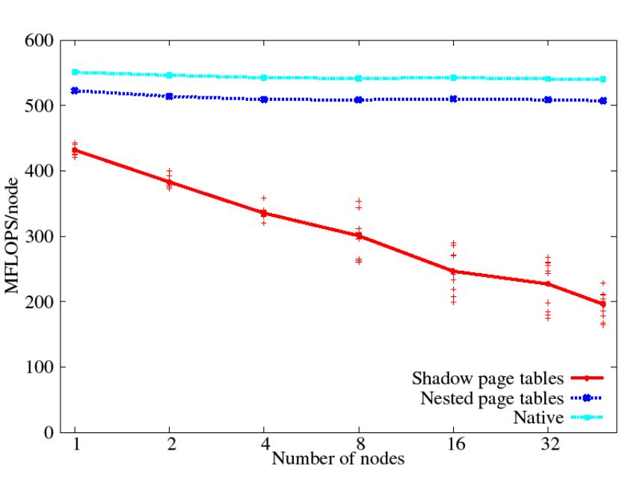
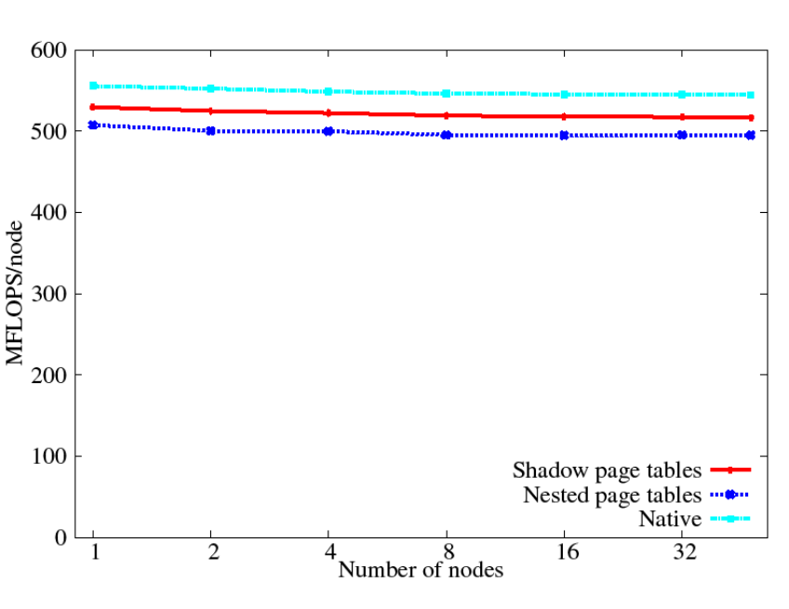
Virtualized Paging
Shadow Paging
Compute Node Linux
Catamount
HPCCG: conjugant gradient solver
Lange, et al (IPDPS 2010)

Slide 16
Virtual Paging mechanisms
Nested Paging
No paging exits
More TLB misses
Good:
  Concentrated access patterns
Bad
  Random access patterns
Shadow Paging
More paging exits
Better TLB behavior
Good
  Infrequent page table modifications
Bad
  Frequent context switches

Slide 17
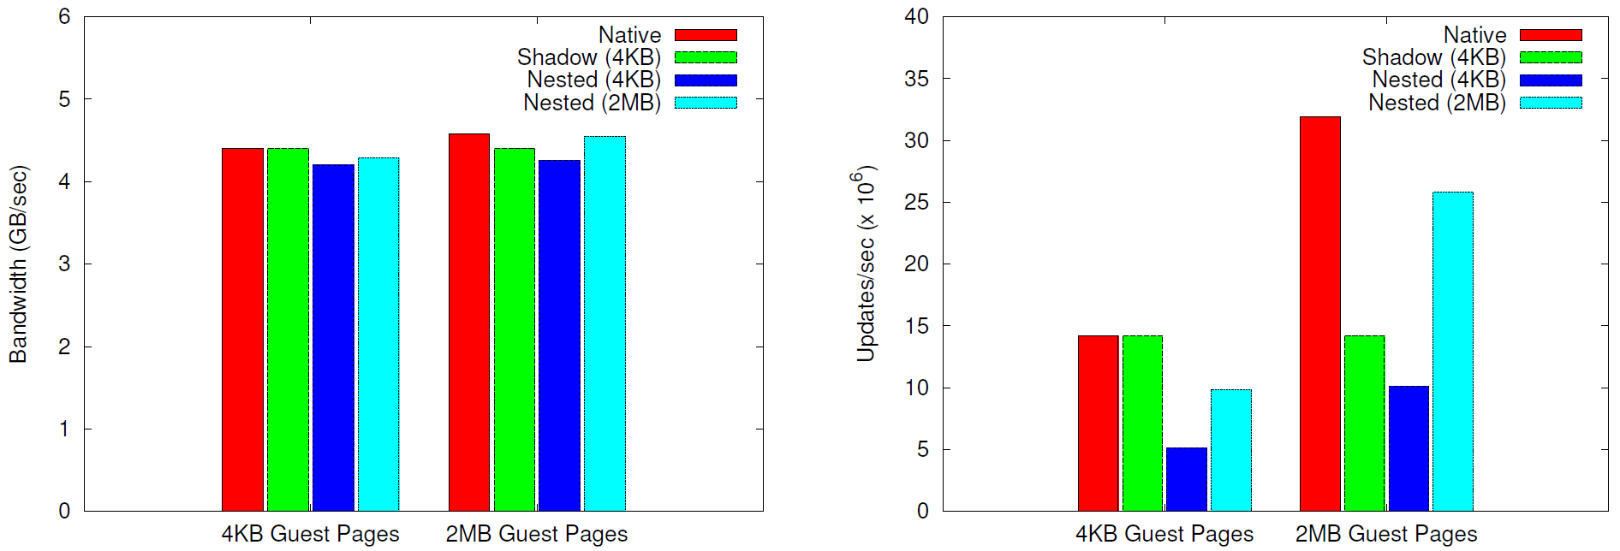
Improving Nested Paging
Palacios + Kitten makes large pages trivial
Palacios preallocates guest in contiguous host memory
  Kitten ensures large page alignment
Stream
Random Access

Slide 18
Selective Virtual Paging
Nested paging does better…
  But shadow paging still performs better with 4KB guest pages
Still need to selectively choose paging approach
Stream
Random Access

Slide 19
Controlled Preemption
OS noise generates a large performance penalty at scale
  Timers, competing kernel threads, etc
  2.5% overhead leads to order of magnitude application performance drop
    Ferreira et al, Supercomputing, 2008
Palacios/Kitten allow per guest control over scheduling
  VM only yields when appropriate
10x reduction in host overhead compared to minimal configuration of KVM/Linux
Notes:
At scale its an issue. 2.5% overhead-> order of magnitude app performance drop
Ferreira 2007 SC

Slide 20
Summary
Virtualization can scale
  Near native performance for optimized VMM/guest
VMM and guests need to cooperate
  Bidirectional information sharing is necessary
Symbiotic Virtualization
  A virtual machine interface designed for guest/VMM cooperation
  2 components
    Guest OS provides internal state to VMM
    Guest OS services requests from VMM
  Interfaces are optional

Slide 21


Conclusion
Palacios:
http://www.v3vee.org/palacios
Kitten:
http://code.google.com/p/kitten/
V3VEE Project:
http://www.v3vee.org

Slide 22
Symbiotic Virtualization in HPC
HPC environments are well suited to symbiotic techniques
Full trust of the software stack
  Fewer security concerns
Specific hardware configurations
  Limited number of devices
Environments are much smaller
  Internal OS state is simpler than a general purpose OS
At large scale performance impact is dramatic
  Large impetus to optimize VMM and OS

Slide 23
Summary
Virtualization can scale
  Near native performance for optimized VMM/guest
VMM needs to know about guest internals
  Should modify behavior for each guest environment
  Example: Paging method to use depends on guest
Black Box inference is not desirable in HPC environment
  Unacceptable performance overhead
  Convergence time
  Mistakes have large consequences
Need guest cooperation
  Guest and VMM relationship should be symbiotic

Slide 24
Summary
Black Box inference is not desirable in HPC environment
  Unacceptable performance overhead
  Convergence time
  Mistakes have large consequences
Need guest cooperation
  Guest and VMM relationship should be symbiotic

