Slide 1


Virtual WiFi: Bring Virtualization from Wired to Wireless
Lei Xia, Sanjay Kumar, Xue Yang
Praveen Gopalakrishnan, York Liu,
Sebastian Schoenberg, Xingang Guo
Northwestern University, EECS
Intel Labs, Hillsboro, OR
This work was done in Intel Labs during Xia’s internship there

Slide 2
Virtual WiFi
New virtualization approach suitable for wireless LAN virtualization
    Full wireless LAN functionalities are supported inside VMs
    Multiple separate wireless LAN connections are supported through one physical wireless LAN network interface

Slide 3

Wireless Virtualization
    Wireless driver stack sits in Host OS only
    VMs see only wired NIC
    Wireless functionality invisible to Guest
    Wireless driver stack runs inside the Guest as well
    Providing rich wireless functionalities to Guest
Guest OS
Guest OS
Guest OS
Guest OS
Wireless Profile
Wireless Profile
Wireless Profile
Wireless Profile
Ethernet Driver
Ethernet Driver
Wireless Driver
Wireless Driver
Host OS
Host OS
VMM
VMM
Ethernet Emulation
Wireless Multiplexing
Wireless Device Driver
Virtualization Augmented
Wireless Driver
Wireless NIC
VVirtualization enabled
Wireless NIC
Today
Virtual WiFi
Notes:
Current approach is to provide virtual ethernet device to VMs based on host WiFi interface, in this case, Guest see only wired network interface instead of WiFi interface. All of wireless connection and profile management are done by VMM. The wireless functions and features are totally invisible to guest at all, also different VMs has to share one wireless connection, and can not connect to different Wireless network/Access Points separately.
On the other hand, the goal of virtual WiFi is to provide legacy/full functioned wireless device interface to virtual machines, so that the guest can use all of wireless functions, save their own wireless configuration or certifies indecently. Moveover, multiple VMs can be connected to different wireless through isolated wireless connections.

Slide 4
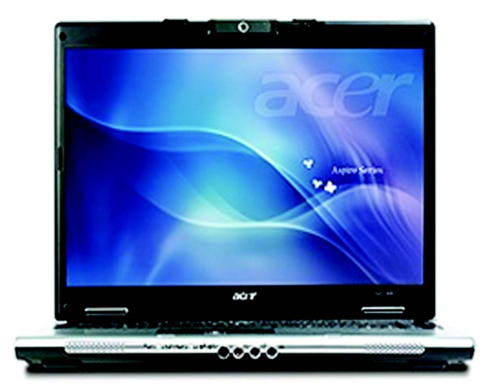
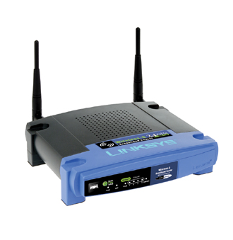
Why we need virtual WiFi?
Client Virtualization
        Enterprise IT: Separate enterprise & personal applications, data and configurations
User
VM
IT
VM
Guest Network
Company Private
Network

Slide 5
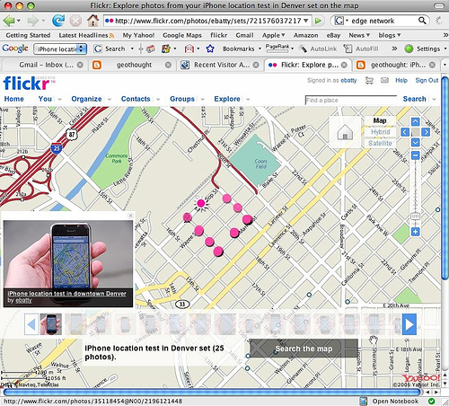
Why we need virtual WiFi?
Mobile and ultra-mobile devices
    Separate work from play
    User connect exclusively through wireless
    Software tools depend on WiFi connectivity
        WiFi-based Location-Aware System
          Maps WiFi hotspots to determine location

Slide 6
Wireless LAN Specific Features
Complex management functions that affect the functionalities of WLAN devices.
    Scan/Associate to specific access point
    Rate adaption
        Dynamic switching data rates to match the channel conditions
    Power management
        Device driver can control how long and how often the radio needs to be on to save battery
    ……
  Device driver has to be involved in many of those management decisions

Slide 7
Required Hardware Support
  Multiple virtual MACs in wireless NIC
    Available on most of commercial WiFi devices, For example, used in Intel MyWiFi technology
    Virtual WiFi extends such technology
      To support wireless virtualization, multiple MAC entities maintain their independent associations with corresponding APs
      Number of independent associations dependent on number of vMACs

Slide 8
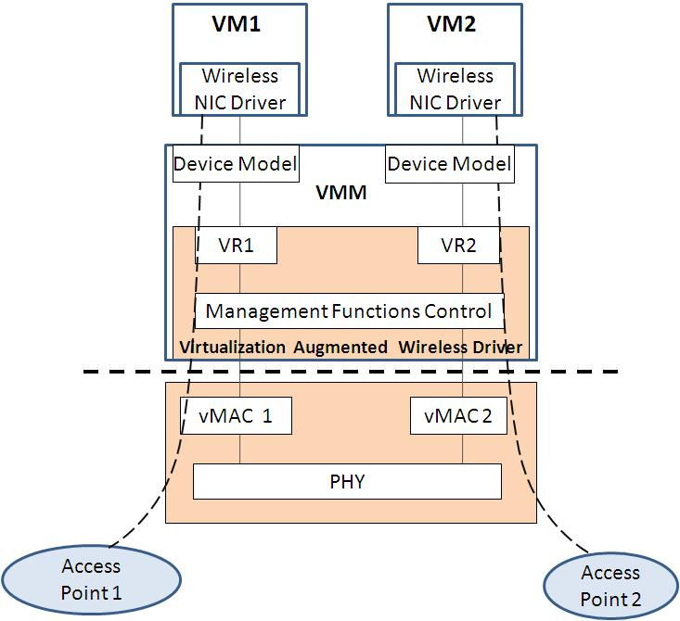
Virtual WiFi: System Architecture

Slide 9
Virtual WiFi: Architecture
VMs run native Intel WiFi device driver
    Using WiFi features from device driver
    Guest manage its own WiFi connections
Notes:
Here is a quick review of what I just described on our virtual WiFi architecture

Slide 10
Virtual WiFi: Architecture
VMs run native Intel WiFi device driver
Device Model exposes same virtual WiFi device to VM as physical device
    Commands from guest can be pass to physical device without translation
    Device model (VMM) knows few about device-specific knowledge
    Wireless vendor minimally dependent of VMM vendor
Notes:
Wireless vendor minimally dependent of VMM vendor, able to provide their own wireless virtualization solution

Slide 11
Virtual WiFi: Architecture
VMs run native Intel WiFi device driver
Expose same virtual WiFi device to VM as physical device
Virtualization Augmented host Wireless device driver
    Management functions of virtualized wireless interfaces
    Logically assigns vMAC to a VM
    Processing commands from device model
        Forwarding them directly or with consolidation or
        Emulated some locally
    Forwarding receive network packet to VMs
    Mapping table between vMAC and VM
        Configuration/connection status/state machine for each vMAC/VM pair
Notes:
Wireless vendor minimally dependent of VMM vendor, able to provide their own wireless virtualization solution

Slide 12
Virtual WiFi: Architecture
  Address Translation
    Commands from guest: GPA->HPA
        Avoids extra memory copy for TX packets
        Either Software/Hardware IOMMU
        Enable VT-d table to support multi-domain for single device
          Collapse multiple page tables to single address translation table in VT-d

Slide 13
Augmented Host Device Driver Commands Handling
TX command
    Pass it directly to associated vMAC on WiFi NIC
Rate Control Command
    Only update the rate table associated with the specific VM-ID
Device Initialization
    Start a new vMAC, and starting state/information mapping to new vMAC
Scan request
    Consolidate properly of scan requests from different VMs
    May return previous stored scan results to VMs
  And a lot more ……

Slide 14
Performance
Benchmarks
    Chariot benchmark tool
    Metrics: TCP & UDP throughputs,
    Ping round-trip latency
  Setup
    HP EliteBook 6930p Laptop with Intel Core2 Duo CPU 2.53GHz (one core used), 4GB RAM, 80GB HD
    Intel WiFi 5300 AGN Card + Cisco WAP410N AP
    KVM + Qemu + Linux 2.6.33.1
Comparing Groups
    Virtual WiFi: VM with virtual WiFi system
    Native: Linux with Native WiFi driver
    Passthrough: VM with direct assigned WiFi device

Slide 15
Performance – TCP Throughputs

Slide 16
Performance - UDP Throughputs

Slide 17
Virtual WiFi: Performance - Latency

Slide 18
VM Additional Latency on TX-path
Address translation takes almost half of the time

Slide 19
System Overall CPU Cost
(single core, 2.53GHz)

Slide 20
Major Virtualization Overheads
Address translation
    Solution: Hardware IOMMU
      IOMMU hw do the address translation
      Reduce the VM additional latency/CPU usage
Notes:
The three major performance overhead parts are address translation, interrupt handling and IO handling. Obviously, this is not surprised. We will go through of them one by one,

Slide 21
Major Virtualization Overheads
Address translation
    Solution: Hardware IOMMU
Interrupt Handling
    Coalesce interrupts disabled in host device driver
    Each physical interrupt leads to more synchronization & signal VMs and kernel
    Solution: Interrupt coalescing in device model

Slide 22
Major Virtualization Overheads
Address translation
    Solution: Hardware IOMMU
Interrupt Handling
    Solution: Interrupt coalescing in device model
I/O handling
    MMIO handling
      Context switches, Threads synchronization overhead for each TX/RX packet
    Solution: Fast data pass-through (Future Work)
        Data traffic passthrough into physical device through separate queue

Slide 23
CPU Usage with Optimizations
Virtual WiFi consumed 9% more CPU than native

Slide 24
Related Work
  MultiNet (Microsoft vWiFi)
    A software layer that abstracts the wireless LAN card hardware into multiple virtual adapters
    Continuously switch the wireless card across multiple wireless networks
Virtual Pass-through IO (VPIO)
    A modeling-based approach to high performance I/O virtualization
    Device is directly assigned to guest
    Most of IOs from a guest are directly applied on physical device, no VMM inventions.
    VMM uses a behavior model to determine when IO has to be intercepted for security and device switching

Slide 25

Summary
Virtual WiFi: new virtualization approach for wireless LAN device
    Support fully wireless functionalities inside VMs
    Separate wireless connections among VMs through one physical wireless interface
Prototype system using virtual WiFi
    Native throughputs with 7% extra latency
    Less than 9% more CPU cost
Lei Xia Ph.D candidate, Northwestern University
http://www.cs.northwestern.edu/~lxi990
http://v3vee.org

Slide 27
Backup Slides
Backup Slides
Backup Slides

Slide 28
Current Wireless virtualization
Map network connections to virtual wired Ethernet device
        Works well for data transfer
        But downsides for wireless connection
          Feature of network infrastructure can not be controlled from inside VM
          Wireless NIC has to be configured and managed by VMM

Slide 29
System profiling setup
  Profiling Components for virtual WiFi system
    Kernel: App-specific, kernel-general
    Kernel modules: KVM, driver
    Application-level: Endpoint, Qemu, Guest
  Presented test results based on KVM/QEMU; similar evaluations need to be performed for other VMM software, such as Xen.

Slide 30
Comparing Groups
Native:
Linux with
native driver
Endpoint
Host
Linux
Kernel
WiFi Driver
(Original Driver)
WiFi Device

Slide 31
Comparing Groups
Qemu
Guest OS
Virtual WiFi
Endpoint
WiFi Driver
Device Model
Host
Linux
Kernel
KVM
WiFi Driver
(Augmented Driver)
WiFi Device

Slide 32
Comparing Groups
Qemu
Guest OS
Passthrough
Endpoint
WiFi Driver
Host Linux Kernel
irtual WiFi Device Mo
KVM
WiFi Device
Notes:
Passthrough case, to simulate and get the expected performance if we have hardware virtualization support

Slide 33
Virtual WiFi: Implementation
Qemu
Guest OS
Native WiFi Driver
Virtual WiFi
Device Model
Application
Host Kernel
KVM
Augmented WiFi Driver
WiFi Device
µCode
Type II hosted VMM
Can be easily ported to Type I bare metal VMM
Notes:
KVM is kernel module to provide processor virtualization support. It relies on processor virtualization support, such as Intel VT-d, or AMD SVM. Qemu is user level Device emulator. It provides device emulation or virtualization support.

Slide 34
Implementation
Virtual WiFi Device Model
    Expose only PCI config and MMIO mapping
    Tag command with VM-ID, Injecting virtual interrupt to VMs.

Slide 35
Implementation
Virtual WiFi Device Model
  Augmented WiFi Device driver
    Forwarding commands directly to physical WiFi device, or Emulated some locally
    Receive network packet from WiFi interface, Identify destination VM, signal device model

Slide 36
Implementation
Vdel
  Augmented WiFi Device driver
Augmented NIC
    Only uCode update needed
    Virtualization extension added to uCode

Slide 37
The CPU Usage Matters!
Scalability
    From 802.11g (50Mbps) to 802.11n (up to 500Mbps)
    CPU usage grows with throughput
Mobile platform
    Limited processor resources
  User experience
Notes:
CPU usage matters.

Slide 38
CPU Usage breakdown (Chariot TX)
Virtualization directed overhead: Guest, Qemu and KVM overhead (20%)
VM Kernel consumes more than Native case (9%)
VM-PT needs very few KVM and Kernel involvement

Slide 39
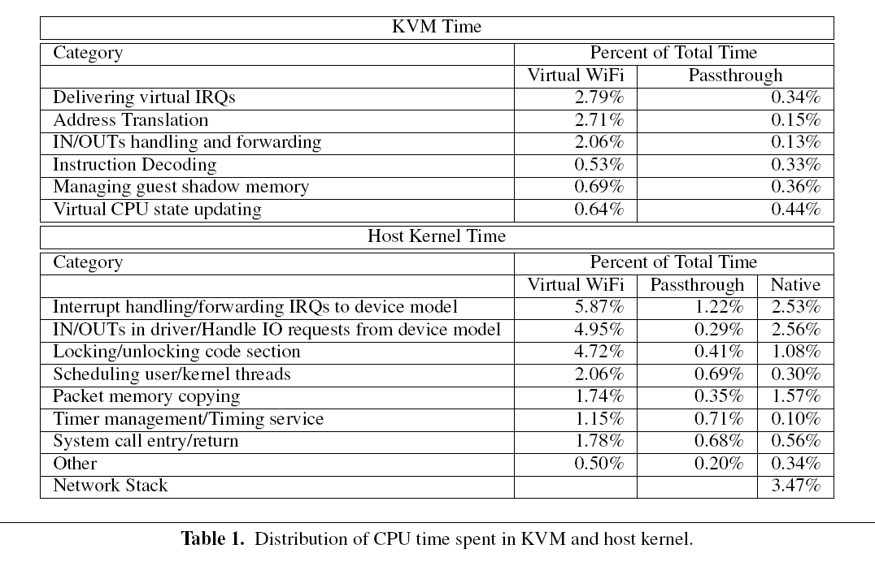
CPU Usage breakdown:
KVM and Host Kernel (by Oprofile)

Slide 40
Future Works
Data Pass-through
    Data traffic passthrough into physical device through separate queue
    Control/management commands go through device model/augmented driver
Apply on next generation WiFi standards
    WiFi 802.11n
    Expected throughput: ~500Mbps

Slide 41
Related Work
Full-virtualization by emulating
    Large performance overhead, Many development efforts, Lack of device datasheets
Para-virtualization
    Need guest modification/new para-virtualized device driver
    WLAN device specific features are closed to VMM vendor for back-end driver
SR-IOV: hardware support virtualization
    Costly/complexity/Time line

